Slide 1


<Mahdi Alimohammadi>
<4/9/2023>

Slide 2

Outline
Executive Summary
Introduction
Methodology
Results
Conclusion
Appendix

Slide 3
Executive Summary
Summary of methodologies
Data Collection
Data Wrangling
EDA data visualization
EDA SQL
Interactive map
Predictive Analysis
Summary of all results
Dashboard
Predictive results

Slide 4
Introduction
Project background and context
Problems you want to find answers

Slide 5

Section 1

Slide 6
Methodology
Executive Summary
Data collection methodology:
spaceX rest API & Web Scrapping
Perform data wrangling
Hot encoding for classification & drop unimportant columns
Perform exploratory data analysis (EDA) using visualization and SQL
Perform interactive visual analytics using Folium and Plotly Dash
Perform predictive analysis using classification models
How to build, tune, evaluate classification models

Slide 7
Data Collection
Datasets are collected from SpaceX Rest API and webscrapping Wikipedia
Rest API
Get json
Make dataframe from json
Clean data
Html response
Rextract data
Make dataframe
Export data

Slide 8
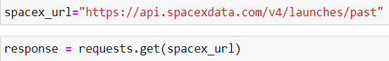
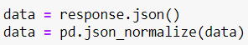
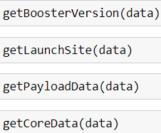
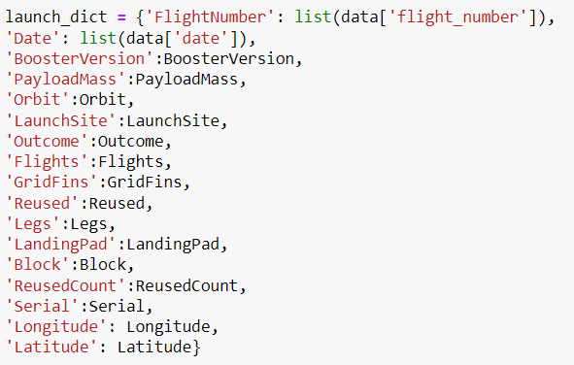
Data Collection – SpaceX API
1.Get response from API
2.Convert response to json
3.Transfrom data
4.Create dictionary
5.Create & filter dataframe
6.Export to file
https://github.com/meti78/My-Files/blob/Data-Science-Capstone/DataCollection_API.ipynb

Slide 9
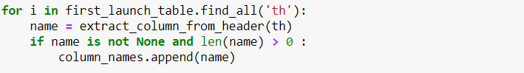
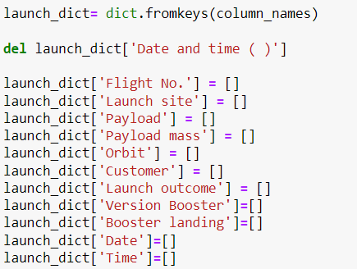
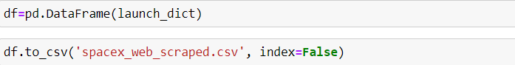
Data Collection - Scraping
1.Get response from Html
2.Create BeautifulSoup
3.Find all tables
4.Get column names
5.Create dictionary
6.Add data to keys
7.Create dataframe and export to file
https://github.com/meti78/My-Files/blob/Data-Science-Capstone/DataCollection_Webscraping.ipynb

Slide 10
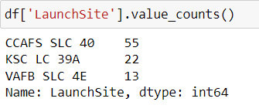
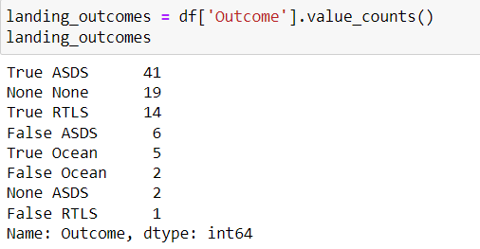
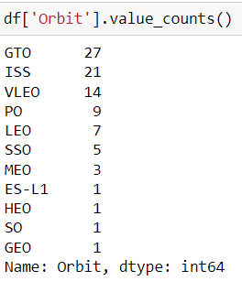
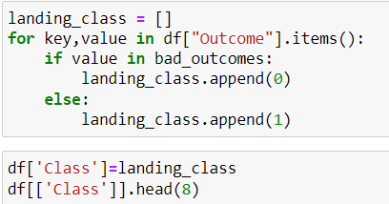
Data Wrangling
1.Calculate launch numbers
2.Calculate number of each orbit
3.Calculate number of mission outcome
4.Create landing outcome label
5.Export to file
https://github.com/meti78/My-Files/blob/Data-Science-Capstone/DataWrangling.ipynb

Slide 11
EDA with Data Visualization
Bar graph
Success rate vs orbit
Line graph
Success rate vs year
Scatter plot
Payload mass vs flight number
Launch site vs flight number
Launch site vs payload mass
Orbit vs success rate
Orbit vs flight number
Orbit vs payload mass
https://github.com/meti78/My-Files/blob/Data-Science-Capstone/EDA_DataVisualization.ipynb

Slide 12
EDA with SQL
Using bullet point format, summarize the SQL queries you performed
https://github.com/meti78/My-Files/blob/Data-Science-Capstone/EDA_SQL.ipynb

Slide 13
Build an Interactive Map with Folium
Summarize what map objects such as markers, circles, lines, etc. you created and added to a folium map
Explain why you added those objects
https://github.com/meti78/My-Files/blob/Data-Science-Capstone/LaunchSiteLocation.ipynb

Slide 14
Build a Dashboard with Plotly Dash
Summarize what plots/graphs and interactions you have added to a dashboard
Explain why you added those plots and interactions
Add the GitHub URL of your completed Plotly Dash lab, as an external reference and peer-review purpose

Slide 15
Predictive Analysis (Classification)
Data preparation
Normalize data and split into train and test sets
Model preparation
Train with different machine learning algorithms
Model evaluation
Compute accuracy for each model
Plot confusion matrix
Model comparison
Compare different models and chose the model with best accuracy
https://github.com/meti78/My-Files/blob/Data-Science-Capstone/Machine%20Learning%20Prediction.ipynb

Slide 16
Results
Exploratory data analysis results
Interactive analytics demo in screenshots
Predictive analysis results

Slide 17

Section 2

Slide 18
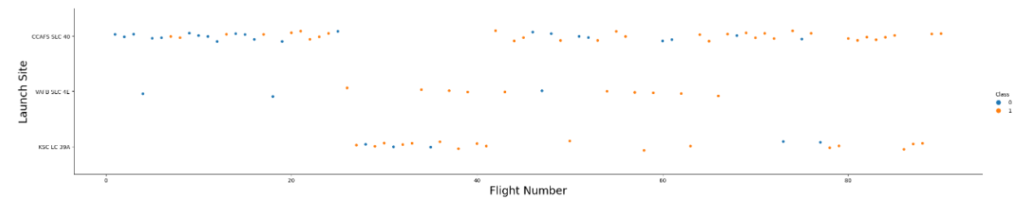
Flight Number vs. Launch Site

Slide 19
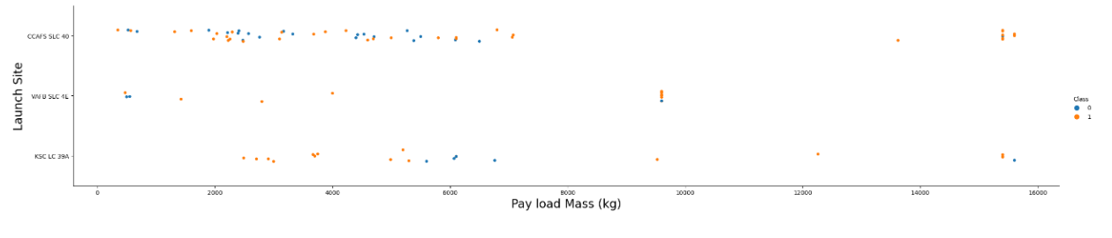
Payload vs. Launch Site

Slide 20
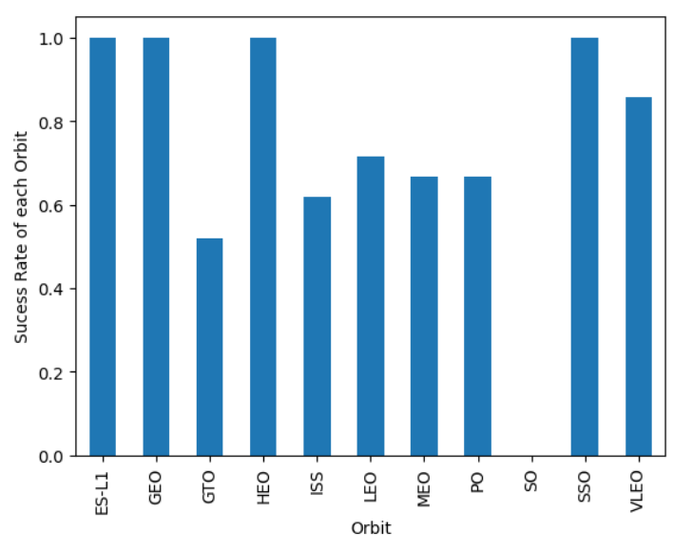
Success Rate vs. Orbit Type

Slide 21
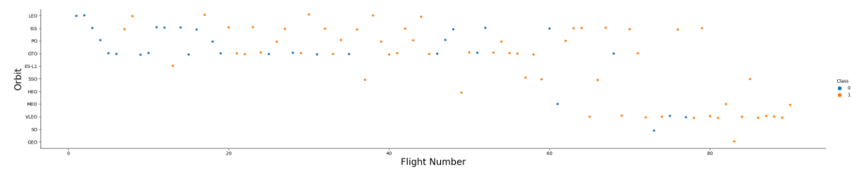
Flight Number vs. Orbit Type

Slide 22
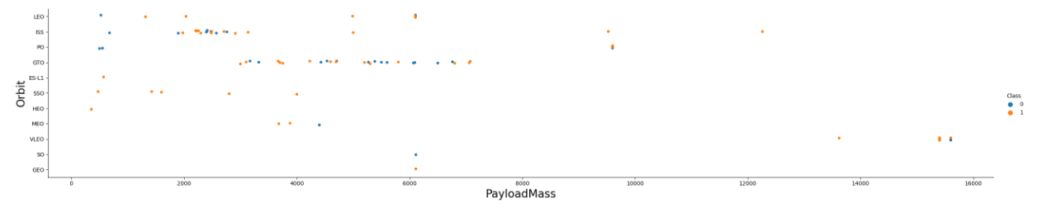
Payload vs. Orbit Type

Slide 23
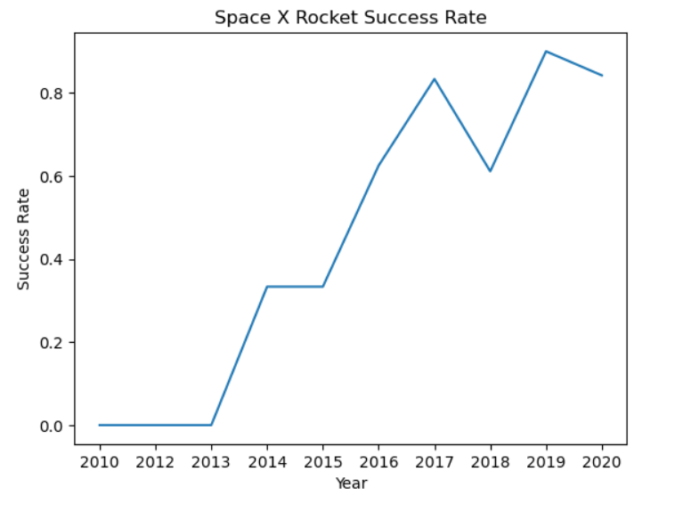
Launch Success Yearly Trend

Slide 24
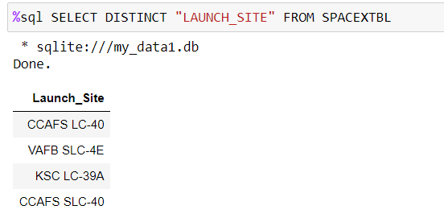
All Launch Site Names
We use “DISTINCT” expression to get each unique launch site name

Slide 25
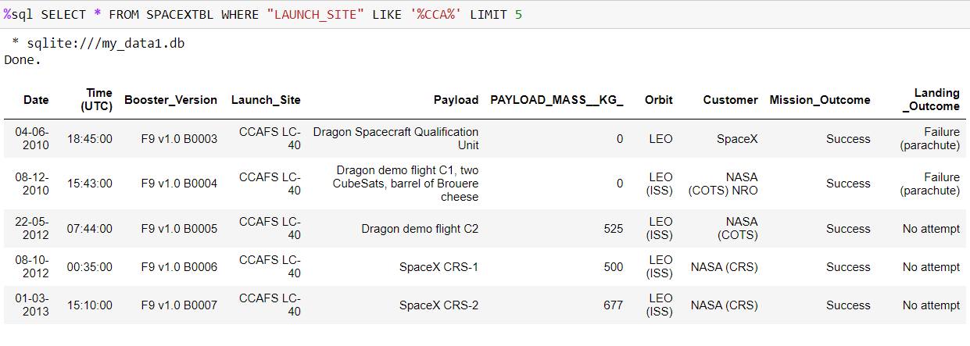
Launch Site Names Begin with 'CCA'
We use “WHERE” and “LIKE” expression to find sites that begin with “CCA”.Then “LIMIT” helps us to show just 5 sites.

Slide 26
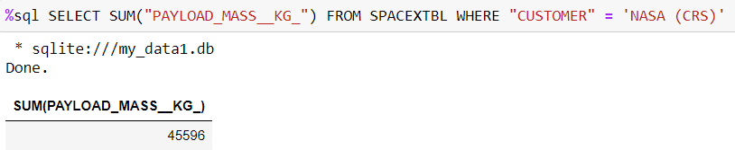
Total Payload Mass
This command returns sum of all payload masses where the customer is NASA.

Slide 27
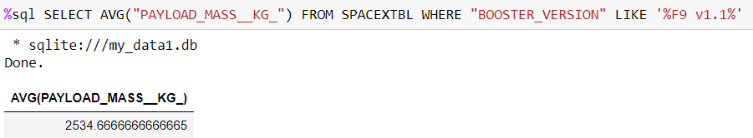
Average Payload Mass by F9 v1.1
This query calculate the average payload mass carried by booster version F9 v1.1

Slide 28
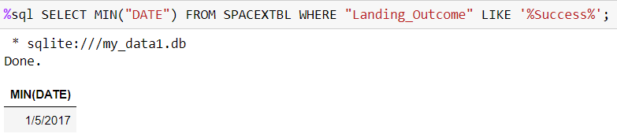
First Successful Ground Landing Date
This query find the dates of the first successful landing outcome on ground pad

Slide 29
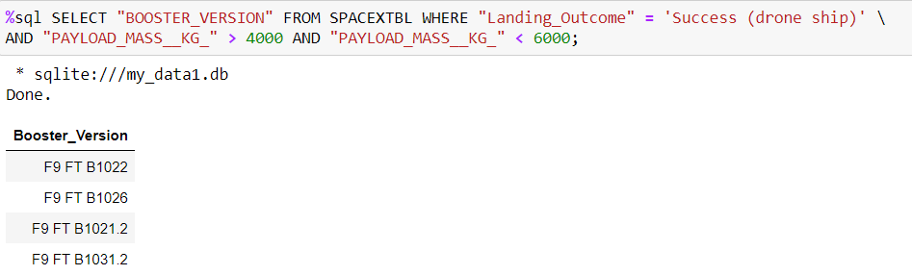
Successful Drone Ship Landing with Payload between 4000 and 6000
This query lists the names of boosters which have successfully landed on drone ship and had payload mass greater than 4000 but less than 6000

Slide 30
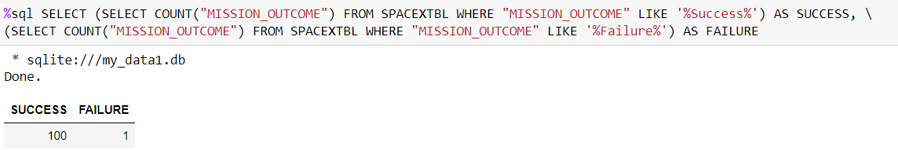
Total Number of Successful and Failure Mission Outcomes
This query calculatec the total number of successful and failure mission outcomes

Slide 31
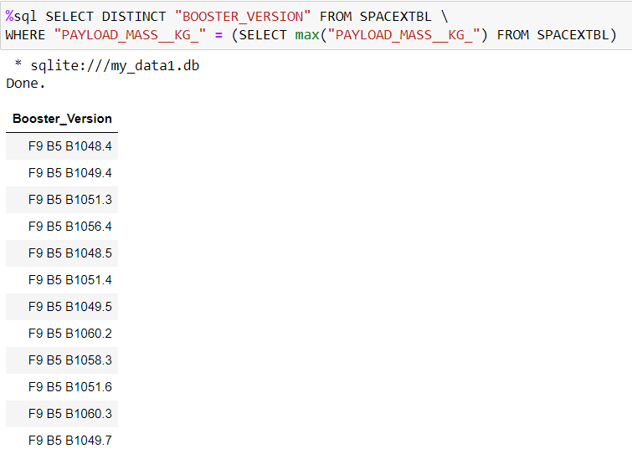
Boosters Carried Maximum Payload
This query lists the names of the booster which have carried the maximum payload mass

Slide 32
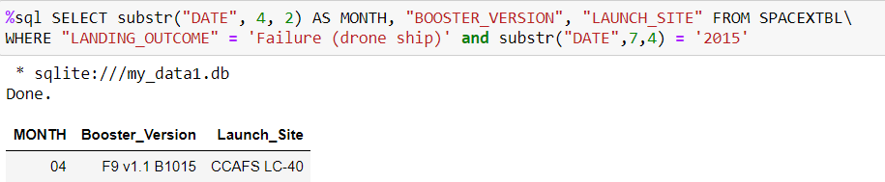
2015 Launch Records
This query lists the failed landing_outcomes in drone ship, their booster versions, and launch site names for in year 2015

Slide 33
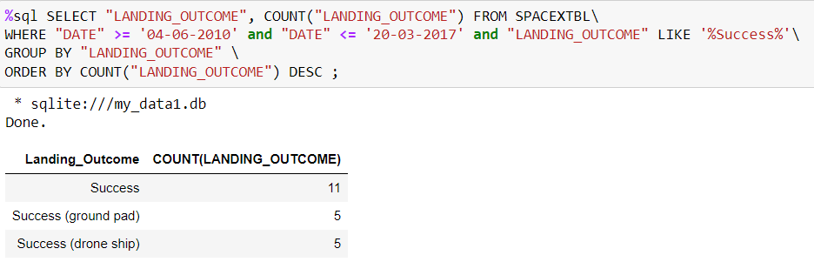
Rank Landing Outcomes Between 2010-06-04 and 2017-03-20
This query Rank the count of landing outcomes (such as Failure (drone ship) or Success (ground pad)) between the date 2010-06-04 and 2017-03-20, in descending order

Slide 34

Section 3

Slide 35
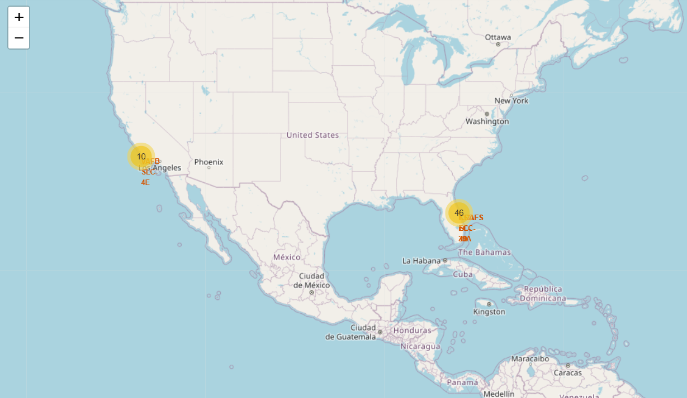
Ground stations

Slide 36
<Folium Map Screenshot 2>
Replace <Folium map screenshot 2> title with an appropriate title
Explore the folium map and make a proper screenshot to show the color-labeled launch outcomes on the map
Explain the important elements and findings on the screenshot

Slide 37
Distances

Slide 38

Section 4

Slide 39
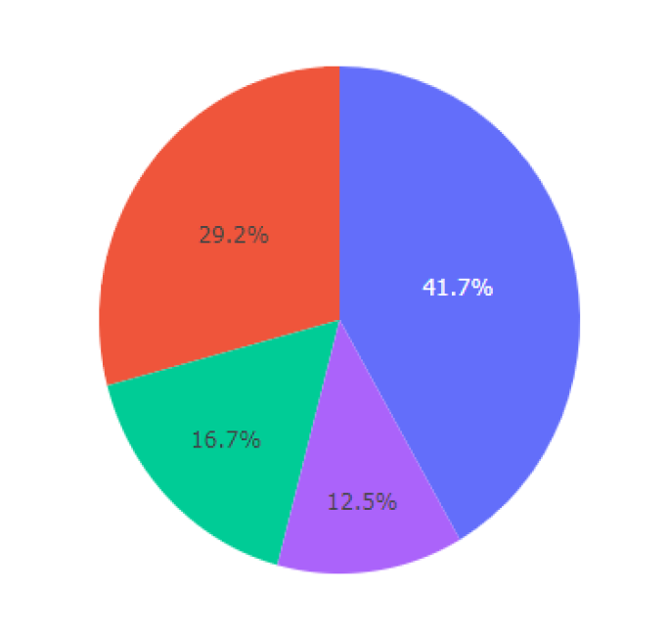
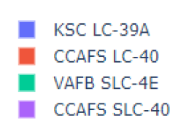
Success count for each site
The chart indicates that the KSC LC-39A has the best success rate.

Slide 40
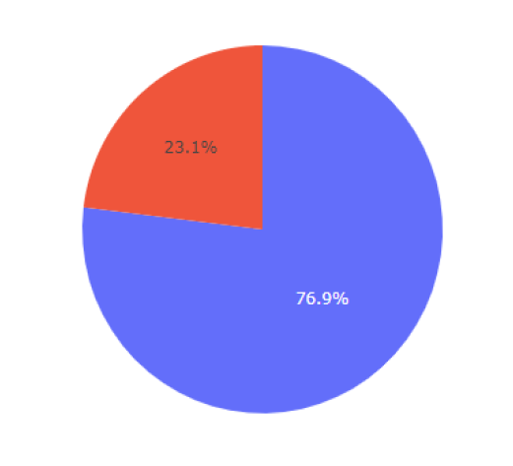
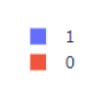
highest launch success ratio
The chart indicates that KSC site has 76.9% success rate and 23.1% failure rate

Slide 41
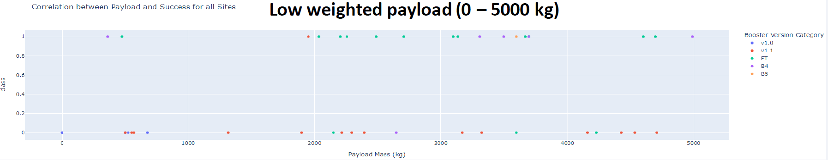
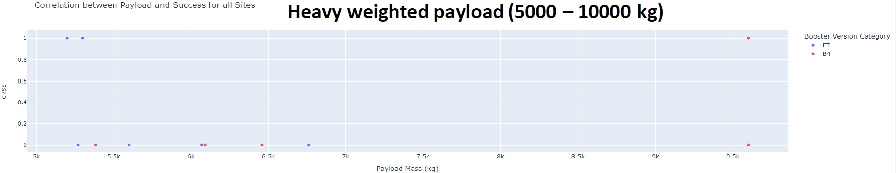
Payload mass vs launch outcome

Slide 42

Section 5

Slide 43
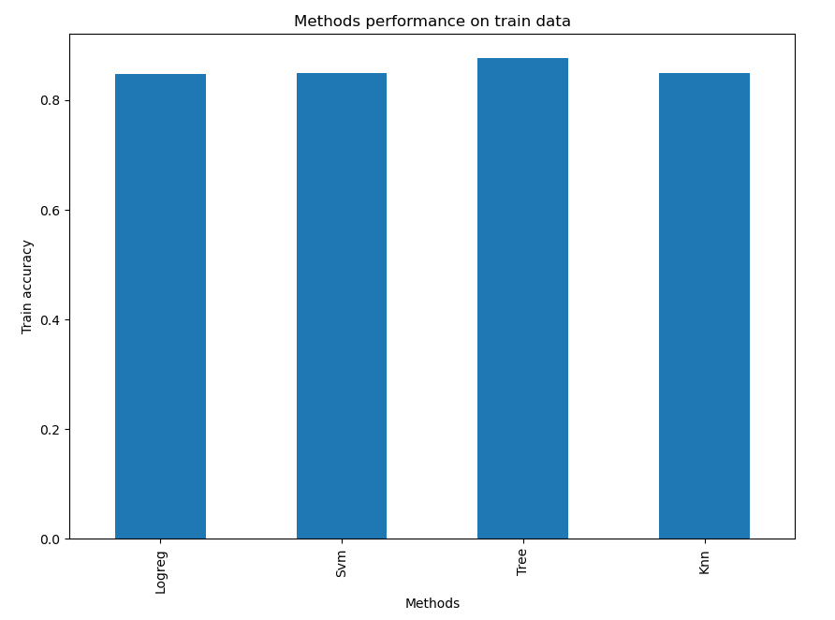
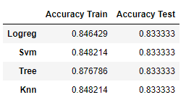
Classification Accuracy
Accuracy of models are very close but decision tree has the most accuracy of all.

Slide 44
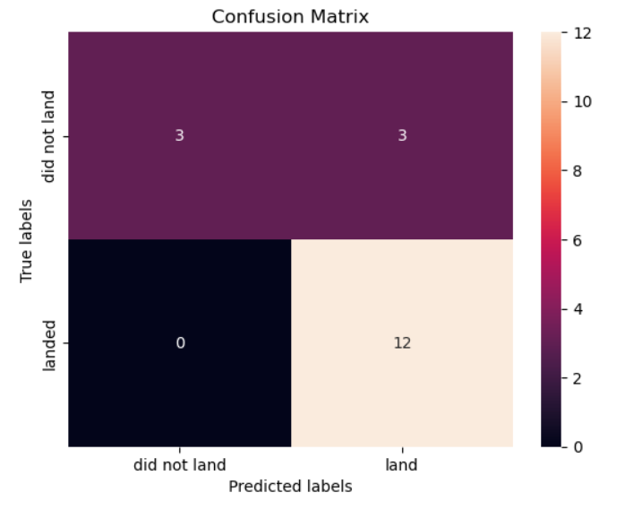
Confusion Matrix
Logistic Regression
KNN
Decision Tree
SVM
As we can see, accuracy of each model is equal based on their confusion matirx

Slide 45
Conclusions
Orbits with the best success rates are GEO, HEO, SSO, ES-L1
Decision Tree algorithm has the best accuracy among other algorithms. Also other algorithms have very great accuracies.
The success of a mission can be explained by several factors such as the launch site, the orbit and especially the number of previous launches. Indeed, we can assume that there has been a gain in

Slide 46


